Slide 1
To-Go ER Diagrams

Slide 2
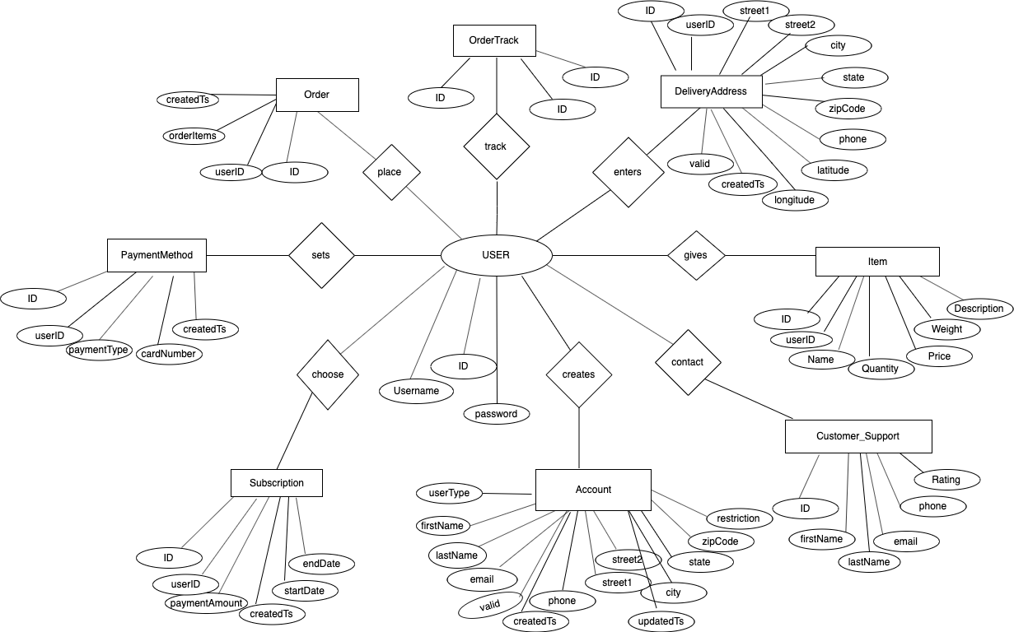
To-Go
CONCEPTUAL ER DIAGRAM
User

Slide 3
To-Go Logical ER Diagram
I3 Scope
USER
PK – ID : INTEGER UserName : VARCHAR Password : VARCHAR
1
1
PAYMENTMETHOD
PK – ID : INTEGER FK – UserID : INTEGER FK – OrderID : INTEGER paymentType : VARCHAR cardNumber : INTEGER createdTS : TIMESTAMP
N
N
CARDINFO
PK – ID : INTEGER FK – UserID : INTEGER FK – OrderID : INTEGER paymentType : VARCHAR cardNumber : INTEGER expirtyDate: VARCHAR zipCode: INTEGER createdTS : TIMESTAMP
1
1

Slide 4
To-Go Logical ER Diagram
I4 Scope
USER
PK – ID : INTEGER UserName : VARCHAR Password : VARCHAR
ORDER
PK – ID : INTEGER FK – UserID : INTEGER FK – OrderID : INTEGER Order item : VARCHAR createdTS : TIMESTAMP
1
1
N
1
ORDER TRACK
PK – Track ID : INTEGER FK – UserID : INTEGER FK – OrderID : INTEGER DeliveryDate : TIMESTAMP OrderStatus: VARCHAR
N
1

